Slide 1


Hybrid Cryptography: Integrating
Block and Stream Ciphers with RSA Encryption for Secure Communication
SUBJECT : CRYPTOGRAPHY
CODE : UE23CS645BC3
Submitted By:
SRN : PES1PG23CS019
NAME : J Thanish Vishaal

Slide 2
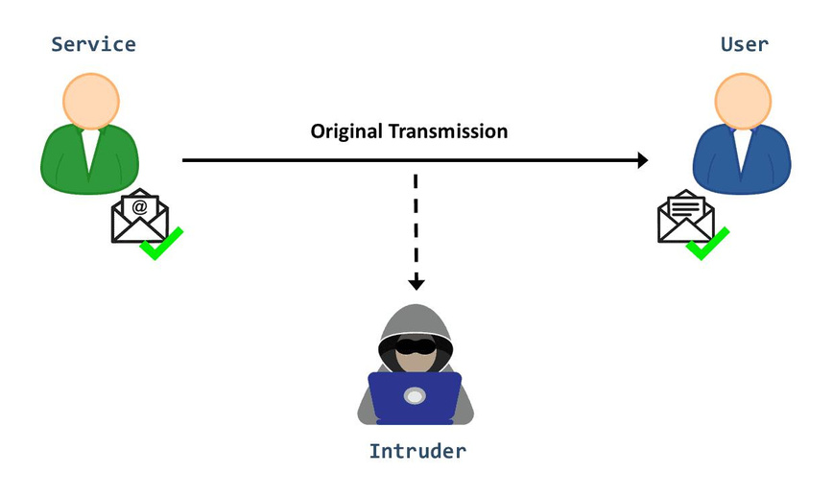

Introduction to Cryptography
Cryptography, the cornerstone of modern security, is the practice and study of techniques for securing communication in the presence of third-party adversaries. This field plays a critical role in safeguarding information from unauthorized access, ensuring that only intended recipients can understand the transmitted data. As technology evolves, the significance of cryptography continues to grow, particularly in the context of digital communication.
Confidentiality: Cryptography ensures that sensitive information remains inaccessible to unauthorized parties. Through encryption, data is transformed into a format that is unreadable to anyone except those possessing the necessary decryption key.
Integrity: This principle guarantees that the information received is exactly as it was sent, without any unauthorized alterations. Cryptographic techniques such as hashing are used to verify that data has not been tampered with during transmission.
Authentication: Beyond protecting data, cryptography also plays a vital role in verifying the identities of the parties involved in communication. This ensures that both the sender and the receiver are who they claim to be, preventing impersonation or unauthorized access.

Slide 3
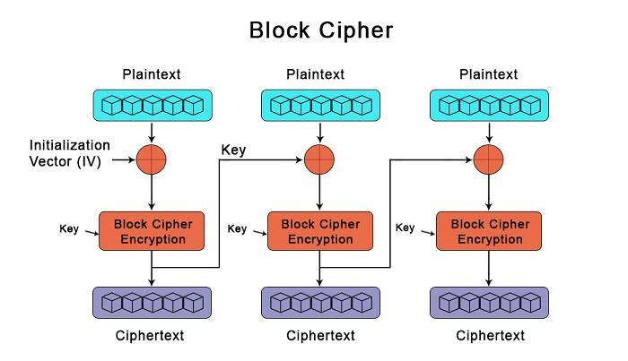
Block Ciphers
A Block cipher is a fundamental cryptographic algorithm used for secure data encryption. Unlike stream ciphers that process data bit by bit, block ciphers work by dividing plaintext into fixed-size blocks (e.g., 64 or 128 bits) and encrypting each block as a single unit. This method ensures that even if a small portion of the plaintext is altered, the resulting ciphertext will be significantly different, enhancing security.
Key Characteristics:
Fixed-Length Blocks: Each block is of a predetermined size, typically 64 or 128 bits. If the plaintext is shorter than the block size, padding is applied to meet the required length.
Deterministic Process: Given the same key and input, a block cipher will always produce the same output, which is vital for ensuring data integrity.
Confusion and Diffusion: Block ciphers employ confusion and diffusion principles to obscure the relationship between the plaintext, the ciphertext, and the key, making it difficult for attackers to deduce the original data or the key.
Modes of Operation: Block ciphers are often used with various modes of operation (e.g., ECB, CBC, CFB, OFB) to enhance security and versatility in different applications.
Examples:
AES (Advanced Encryption Standard): Widely used for its security and efficiency.
DES (Data Encryption Standard): An older standard, now considered insecure for modern usage.

Slide 4
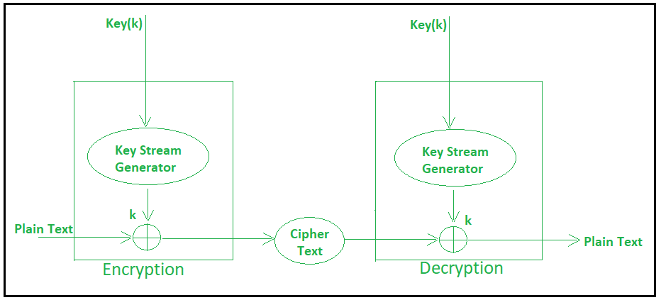
Stream Ciphers
Stream ciphers are a type of symmetric-key encryption algorithm that encrypts plaintext data one bit or byte at a time, rather than in large blocks. This approach allows for faster encryption and is particularly suited for environments where data needs to be encrypted on-the-fly, such as in real-time communication systems. Unlike block ciphers, which require data to be divided into fixed-size blocks, stream ciphers generate a keystream of pseudorandom data that is XORed with the plaintext to produce ciphertext.
Key Characteristics:
Simplicity: Stream ciphers are generally simpler to implement and require less computational power, making them ideal for scenarios with limited processing resources.
Speed: Stream ciphers are typically faster than block ciphers, especially when encrypting large streams of data. Their ability to encrypt data bit by bit or byte by byte provides a performance advantage in streaming and real-time applications.
No Padding Required: Since stream ciphers operate on individual bits or bytes, there is no need for padding, which can be required in block ciphers to fill up incomplete blocks.
Examples:
RC4 (Rivest Cipher 4): A widely-used but now outdated stream cipher.
ChaCha20: A modern, more secure and efficient stream cipher.

Slide 5
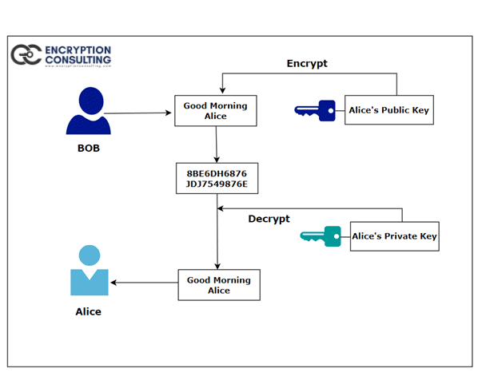
RSA Encryption
RSA (Rivest-Shamir-Adleman) encryption is a widely-used asymmetric-key cryptographic algorithm that leverages the mathematical properties of large prime numbers. Unlike symmetric-key algorithms that use the same key for both encryption and decryption, RSA uses a pair of keys—a public key for encryption and a private key for decryption. This key pair ensures that even if the public key is widely distributed, only the holder of the private key can decrypt the messages encrypted with the corresponding public key.
Key Features:
Security:
The security of RSA relies on the practical difficulty of the prime factorization of very large numbers. As long as the key length is sufficiently large, RSA remains secure against brute-force attacks and factorization-based attacks.
Digital Signatures:
RSA can also be used for digital signatures, where a message is signed using a private key and verified with the corresponding public key. This ensures both the authenticity and integrity of the message.
Widespread Use:
RSA is extensively used in securing data transmissions, especially in securing web traffic via SSL/TLS, email encryption, and digital signatures. It forms the backbone of many modern cryptographic protocols.

Slide 6
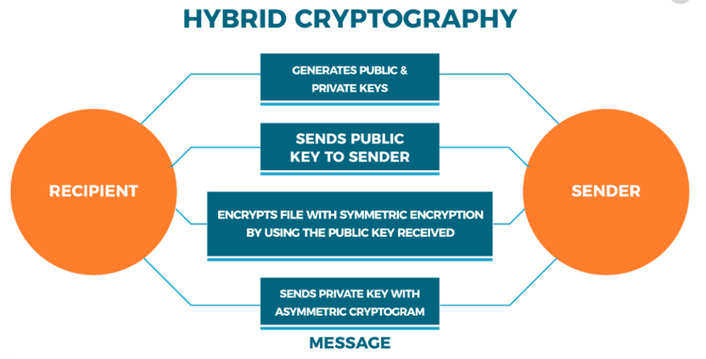
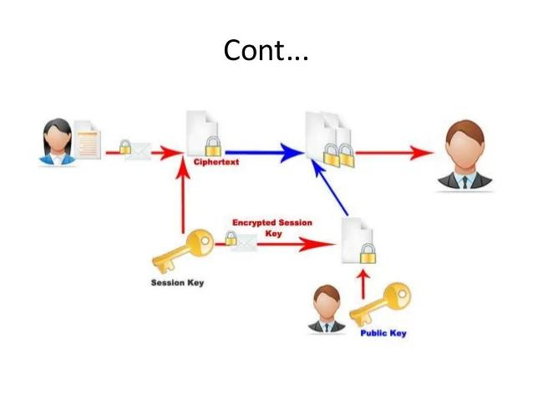
Hybrid Cryptography
Hybrid cryptography is a method that combines the strengths of both symmetric-key cryptography and asymmetric-key cryptography to secure communication. By leveraging the efficiency of symmetric encryption for data transfer and the security of asymmetric encryption for key exchange, hybrid cryptography offers a practical solution to the challenges of secure and efficient communication over insecure networks.
Advantages of Hybrid Cryptography:
Security:
Combining symmetric and asymmetric encryption provides a robust security model, protecting both the data and the keys used for encryption.
Performance:
By using symmetric encryption for data transmission, hybrid cryptography ensures high performance, even for large amounts of data.
Key Management:
Asymmetric encryption simplifies key distribution and management, while symmetric encryption provides a fast and efficient means of securing data.

Slide 7
System Design
The system utilizes a hybrid cryptography approach, combining both symmetric and asymmetric encryption to ensure data confidentiality, integrity, and authenticity
Key Components:
Alice (Client):
Role:
Alice acts as the client in this cryptographic communication system. Her primary function is to initiate communication by sending encrypted messages to Bob and decrypting messages received from Bob.
Functionalities:
Key Pair Generation
Encryption & Decryption
Data Transmission
Bob (Server):
Role:
Bob acts as the server in the system, responsible for receiving encrypted messages from Alice, decrypting them, and optionally responding with encrypted messages.
Functionalities:
Key Pair Generation
Encryption & Decryption
Data Transmission

Slide 8
System Design
Integration of Cryptographic Algorithms:
Symmetric Encryption (Block and Stream Ciphers):
Block Ciphers (e.g., AES):
Block ciphers divide the plaintext into fixed-size blocks and encrypt each block individually using a symmetric key. This method ensures that the entire message is securely encrypted, even if it is larger than the block size.
Example: Alice encrypts her message using AES, creating ciphertext blocks that are sent to Bob.
Stream Ciphers (e.g., ChaCha20):
Stream ciphers encrypt the plaintext bit by bit or byte by byte, using a key stream generated from the symmetric key. This method is efficient for real-time data encryption and is less susceptible to certain types of cryptanalysis.
Example: If Alice chooses to use ChaCha20, her message is encrypted in a continuous stream, ensuring quick encryption of even large datasets.
Asymmetric Encryption (RSA):
Key Exchange:
RSA is used for the secure exchange of symmetric keys. Alice and Bob share their public keys to securely transmit the session key used for symmetric encryption along with the ciphertext.
Data Encryption:
Although less common due to its computational intensity, RSA can also be used for encrypting small pieces of data, such as digital signatures or small messages.

Slide 9
System Design
Socket Programming for Communication:
Overview:
The system uses socket programming to establish a connection between Alice and Bob over the network. Sockets allow for the sending and receiving of data between the client and server, ensuring that the communication channel remains open and reliable.
Process:
Connection Establishment
Data Transmission
Termination
System Security Features:
Mutual Authentication:
Both Alice and Bob authenticate each other using their public and private keys. This ensures that both parties are who they claim to be, preventing man-in-the-middle attacks.
Confidentiality:
The combination of symmetric and asymmetric encryption ensures that only the intended recipient can decrypt and access the message content.
Session Key Management:
Session keys are generated for each communication session and are only valid for the duration of that session. This approach minimizes the risk of key compromise and enhances overall system security.

Slide 10
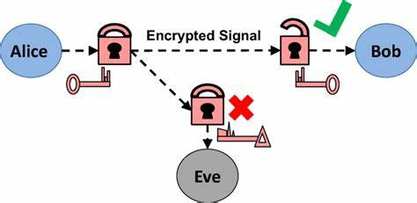
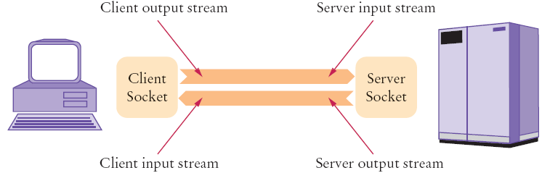
Working of the Code
1. Alice's Code (alice_client.py)
Purpose: Implements the client-side of the communication system. Alice's code encrypts messages using symmetric encryption (AES or chacha20), and then sends the message to the server after encrypting the cipher message with bob’s public key. It also handles receiving and decrypting ciphertexts.
2. Bob's Code (bob_server.py)
Purpose: Implements the server-side of the communication system. Bob's code handles receiving messages from Alice, decrypts them, and also sends back encrypted ciphertexts to Alice .

Slide 11
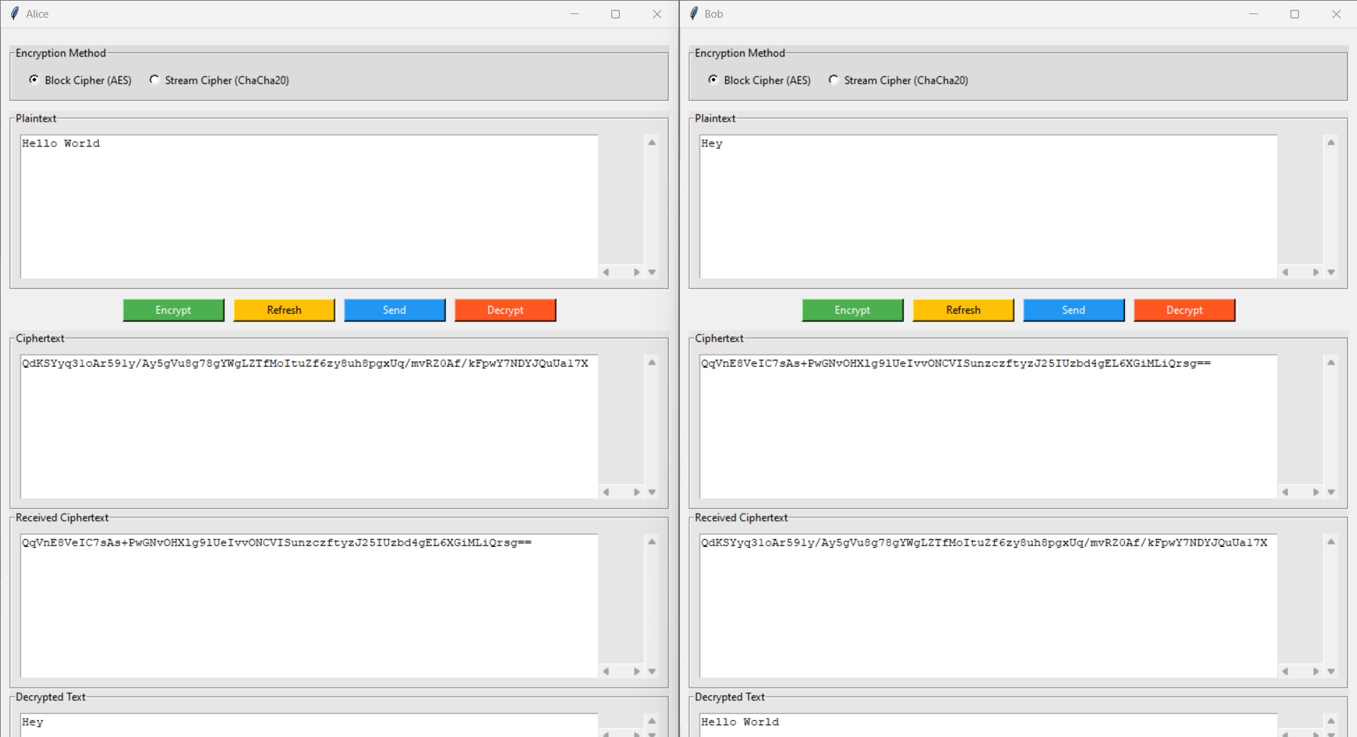
GUI Interface

Slide 12
Security Analysis
Potential Security Threats:
Brute-Force Attacks:
Description: An attacker systematically attempts all possible keys until the correct one is found. This attack is feasible if the key length is too short.
Mitigation: Use sufficiently long keys (e.g., AES-256) and implement strong key management practices to prevent unauthorized access.
Side-Channel Attacks:
Description: Exploits information leaked during cryptographic operations, such as timing information, power consumption, or electromagnetic emissions.
Mitigation: Employ countermeasures like constant-time algorithms and physical shielding to minimize information leakage.
Man-in-the-Middle Attacks:
Description: An attacker intercepts and potentially alters the communication between two parties without their knowledge.
Mitigation: Use digital signatures and mutual authentication to verify the identity of the communicating parties and ensure data integrity.
Replay Attacks:
Description: An attacker intercepts a valid data transmission and retransmits it to gain unauthorized access or disrupt communication.
Mitigation: Incorporate timestamps or unique session identifiers to detect and prevent replayed messages.

Slide 13
Security Analysis
Countermeasures:
Key Exchange Protocols:
Description: Secure methods for exchanging cryptographic keys over an insecure channel. Examples include Diffie-Hellman key exchange and Elliptic Curve Diffie-Hellman (ECDH).
Authentication Mechanisms:
Description: Methods to verify the identity of users or systems to prevent unauthorized access. Examples include passwords, biometrics, and two-factor authentication (2FA).
Secure Coding Practices:
Description: Techniques and practices to write secure code that is resistant to vulnerabilities. This includes input validation, error handling, and avoiding common pitfalls like buffer overflows.
Summary of Security Measures:
Strong Encryption: Utilize robust encryption algorithms (AES-256) and ensure proper key management to secure data.
Integrity Checks: Implement hashing (SHA-256) to verify that data has not been tampered with during transmission.
Authentication and Authorization: Use secure methods to authenticate and authorize communication between Alice and Bob, ensuring that only legitimate parties can access and exchange information.
Continuous Monitoring and Updates: Regularly monitor for vulnerabilities and update cryptographic methods and protocols as needed to address emerging threats.

Slide 14
Conclusion
Final Thoughts:
Importance of Cryptography: Cryptography is a critical component in safeguarding information in the digital age. It ensures that data remains confidential, integral, and authentic, protecting against unauthorized access and tampering.
Robust Solutions for Secure Communication: By integrating block ciphers, stream ciphers, and RSA encryption, the system achieves a robust security framework. This hybrid approach addresses the needs for both strong data protection and secure key exchange, enhancing overall communication security.
Ongoing Vigilance: Security is an evolving field, and continuous monitoring, updating, and improving cryptographic practices are essential to stay ahead of emerging threats. Regularly review and update cryptographic systems to adapt to new vulnerabilities and challenges.
Key Takeaways:
Cryptographic Techniques: Understanding and correctly implementing block and stream ciphers, along with RSA encryption, is vital for developing secure communication systems.
Hybrid Approach: offers a balance between security and performance, ensuring efficient data encryption while maintaining secure key exchange and authentication processes.
Security Best Practices: Employ strong encryption algorithms, implement secure key management, and follow best practices in cryptography and secure coding to ensure effective protection of sensitive information.

